Slide 1
Project 1
ONOS and Mininet Installation
Environment Setup &
Basic Operation
Date : | 2019/03/05 (Fri.) 12:30
Deadline: | 2019/03/11 (Thu.) 23:59

Slide 2





Overview
Virtual Machine
ONOS
Use ONOS GUI to
see the topology
switch
switch
switch
host
switch
host
Mininet

Slide 3
Outline
Environment Setup
VirtualBox Installation
Bazel, ONOS, Mininet and OVS Installation
Basic Operation
Start ONOS
ONOS CLI
ONOS Web GUI
Activate basic ONOS APPs
[Method 1] Via ONOS CLI
[Method 2] Via ONOS GUI
Create a topology controlled by ONOS
[Method 1] Via Mininet CLI
[Method 2] Custom Topology
Project Requirements
Part 1: Answer Questions
Part 2: Write a Custom Topology
Bonus: Specify Hosts IP Address In Mininet

Slide 4
Outline
Environment Setup
VirtualBox Installation
Bazel, ONOS, Mininet and OVS Installation
Basic Operation
Project Requirements

Slide 5
Environment Setup
VirtualBox & ONOS & Mininet

Slide 6
Outline
Environment Setup
VirtualBox Installation
Bazel, ONOS, Mininet and OVS Installation
Basic Operation
Project Requirements

Slide 7
Virtualbox Installation
Oracle VM VirtualBox:
a free and open-source hosted hypervisor for x86 virtualization,
developed by Oracle Corporation.
Environment
Ubuntu Desktop 16.04 (or 18.04) recommended
Minimum Hardware settings
2 Cores
8GB RAM
20GB HDD
For more installation detail, please refers to:
SDN_Environment_Setup.pdf

Slide 8
Outline
Environment Setup
VirtualBox Installation
Bazel, ONOS, Mininet and OVS Installation
Basic Operation
Project Requirements

Slide 9



Bazel, ONOS, Mininet and OVS Installation
Bazel: free SW tool for “automation of building and testing of SW”.
https://bazel.build/
Mininet: An instant virtual network on your computer
http://mininet.org/
OVS (Open vSwitch): a multilayer software switch licensed under the open source Apache 2 license.
https://www.openvswitch.org/
ONOS (Open Network Operating System): open source SDN controller The controller of SDN network
https://www.opennetworking.org/onos/
Installation:
Use TA-provided env_setup.sh

Slide 10
Outline
Environment Setup
Basic Operation
Start ONOS
ONOS CLI
ONOS Web GUI
Activate basic ONOS APPs
[Method 1] Via ONOS CLI
[Method 2] Via ONOS GUI
Create a topology controlled by ONOS
[Method 1] Via Mininet CLI
[Method 2] Custom Topology
Project Requirements

Slide 11
Basic Operation
ONOS APPs & Custom Topo

Slide 12
Outline
Environment Setup
Basic Operation
Start ONOS
ONOS CLI
ONOS Web GUI
Activate basic ONOS APPs
[Method 1] Via ONOS CLI
[Method 2] Via ONOS GUI
Create a topology controlled by ONOS
[Method 1] Via Mininet CLI
[Method 2] Custom Topology
Project Requirements

Slide 13
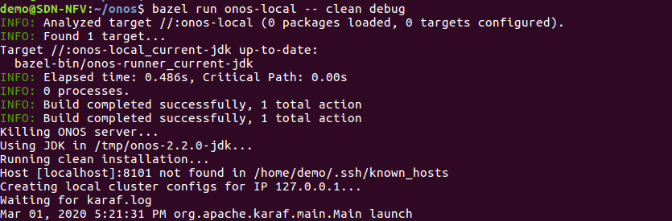
Start ONOS
Start ONOS server in localhost
The INFO “Updated node 127.0.0.1 state to READY” means that ONOS is successfully initiated
demo@SDN-NFV:~$ cd $ONOS_ROOT
demo@SDN-NFV:~/onos$ bazel run onos-local -- clean debug
# option 'clean' to delete all previous running status
# option 'debug' to enable remote debugging (port 5005)

Slide 14
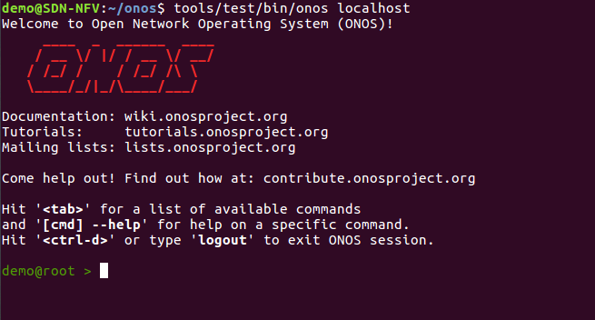
ONOS CLI
Bring up another new terminal and enter ONOS CLI
ONOS command “logout” to exit ONOS CLI
demo@SDN-NFV:~$ cd $ONOS_ROOT
demo@SDN-NFV:~/onos$ tools/test/bin/onos localhost
demo@root > logout

Slide 15
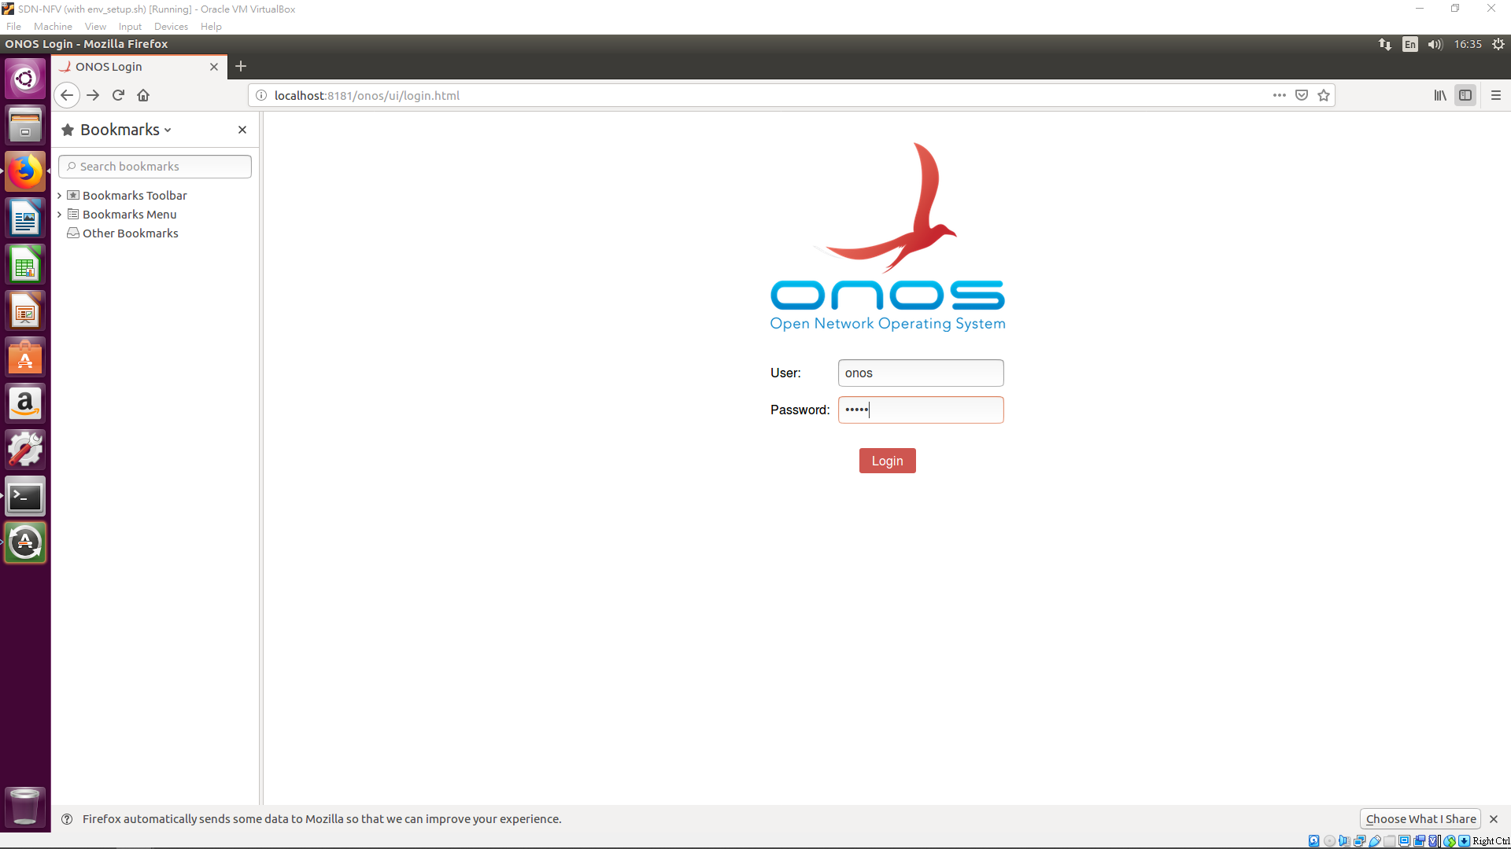
ONOS Web GUI
Open web browser (e.g. Firefox)
visit http://localhost:8181/onos/ui
User/ Password: onos/ rocks
ONOS GUI (Graphical User Interface) tutorial
https://wiki.onosproject.org/display/ONOS/Basic+ONOS+Tutorial#BasicONOSTutorial-ONOSGraphicalUserInterface
Notes:
說明MININET會預設掛HOST+圖
截圖上方不需要

Slide 16
Outline
Environment Setup
Basic Operation
Start ONOS
ONOS CLI
ONOS Web GUI
Activate basic ONOS APPs
[Method 1] Via ONOS CLI
[Method 2] Via ONOS GUI
Create a topology controlled by ONOS
[Method 1] Via Mininet CLI
[Method 2] Custom Topology
Project Requirements

Slide 17
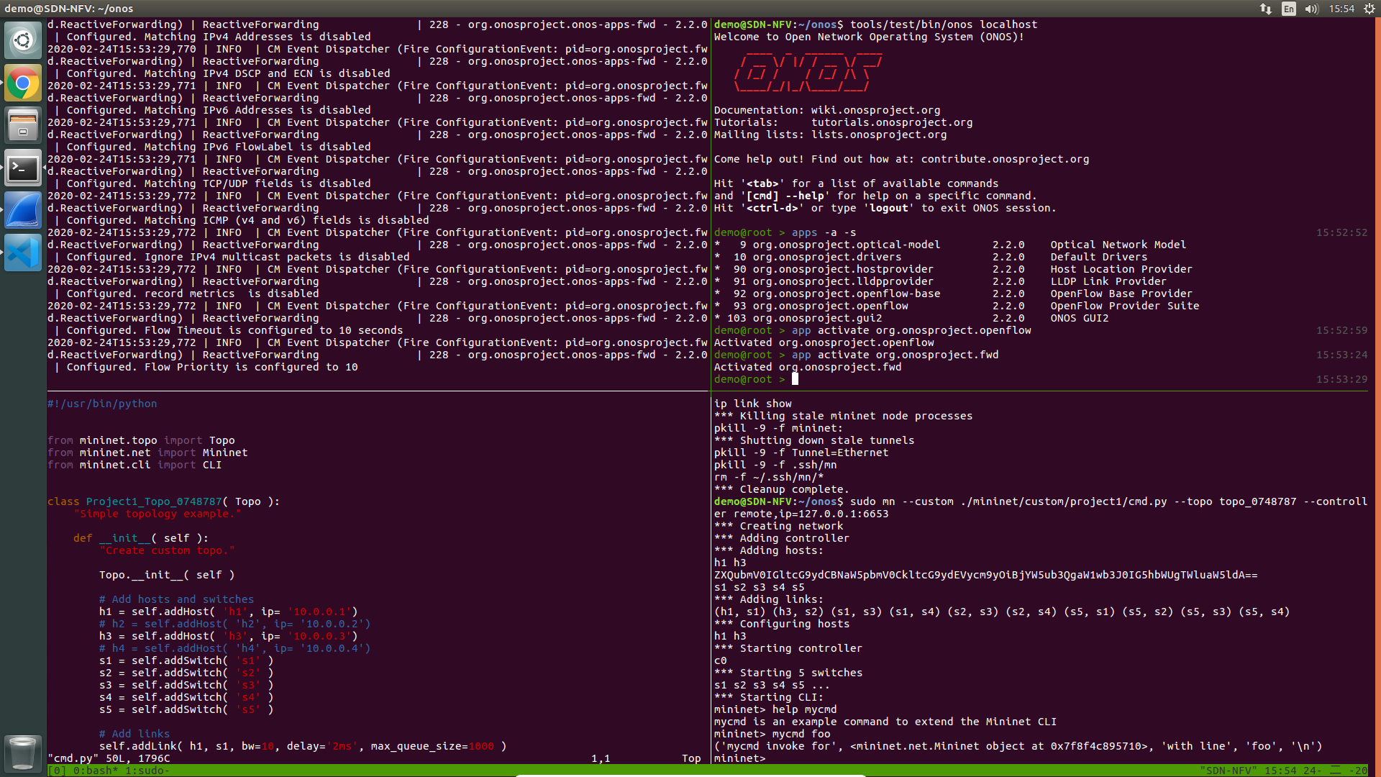
Activate basic ONOS APPs (Via ONOS CLI)
[Method 1]
Note: Use the following command to get more usage information
onos> apps -a -s # Show activated apps only
onos> app activate <name>
onos> app --help # display command help message

Slide 18
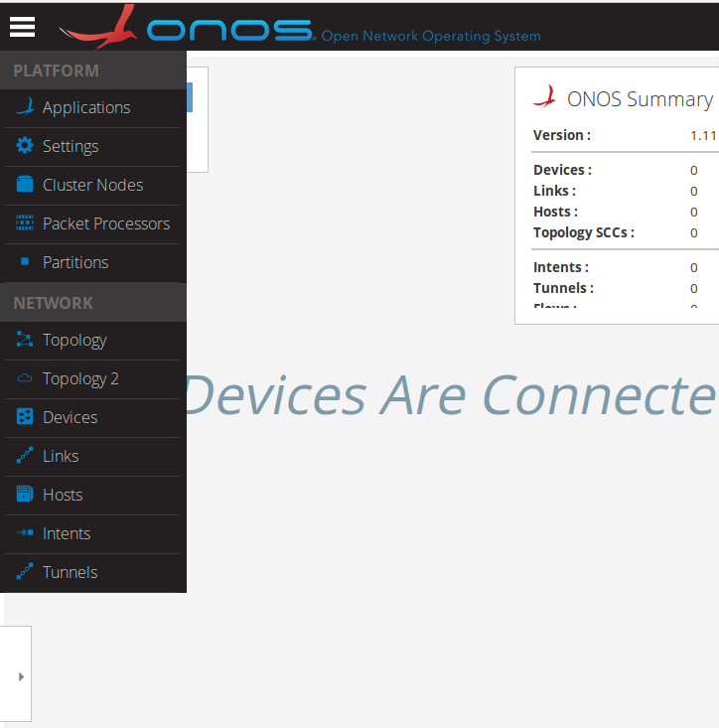
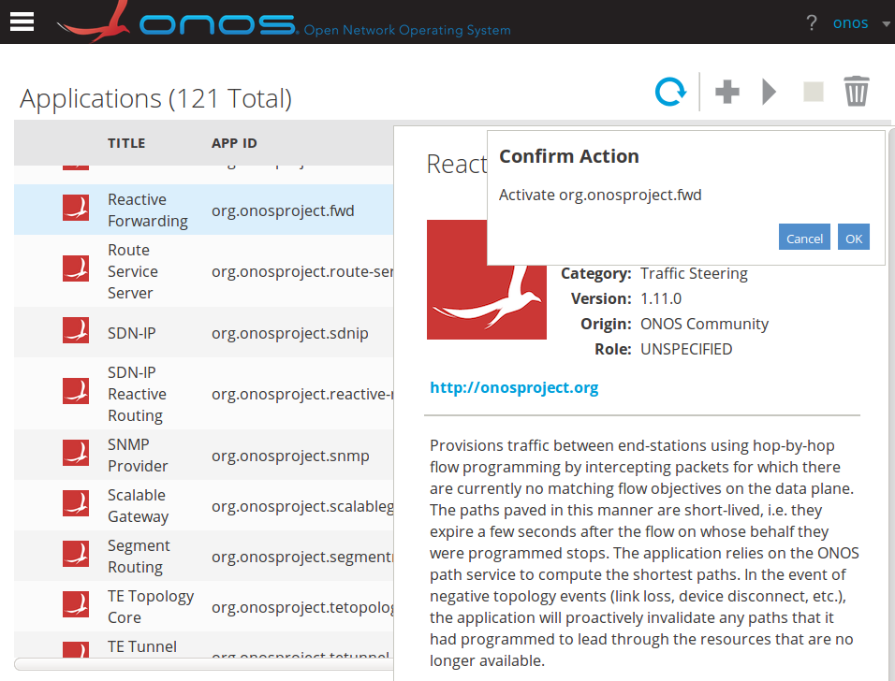
Activate basic ONOS APPs (Via ONOS GUI)
[Method 2]
Click
Choose “Applications”
Choose “Reactive Forwarding”
Click
Click “OK”
1
4
2
3
5

Slide 19
Outline
Environment Setup
VirtualBox Installation
Bazel, ONOS, Mininet and OVS Installation
Basic Operation
Start ONOS
Activate basic ONOS APPs
Create a topology controlled by ONOS
[Method 1] Via Mininet CLI
Create a topology in Mininet controlled by ONOS
Make hosts appear in ONOS GUI
[Method 2] Custom Topology
Project1 requirements

Slide 20
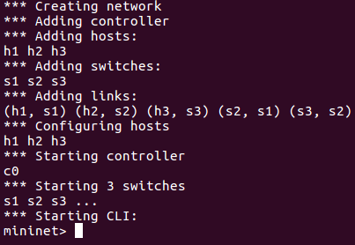

Create a topology in Mininet controlled by ONOS
Run Mininet with “--topo” & “--controller” options
In this built-in topology, each switch would have one host
“--controller” option adds remote controller
Use command “exit” in Mininet CLI to exit Mininet CLI
$ sudo mn --topo=linear,3 --controller=remote,127.0.0.1:6653
Controller
(ONOS)
127.0.0.1:6653
s1
s2
s3
h1
h2
h3

Slide 21
Create a topology in Mininet controlled by ONOS
Note: Be sure to clean up the environment of Mininet after every time you exit Mininet CLI
$ sudo mn -c #clean and exit

Slide 22
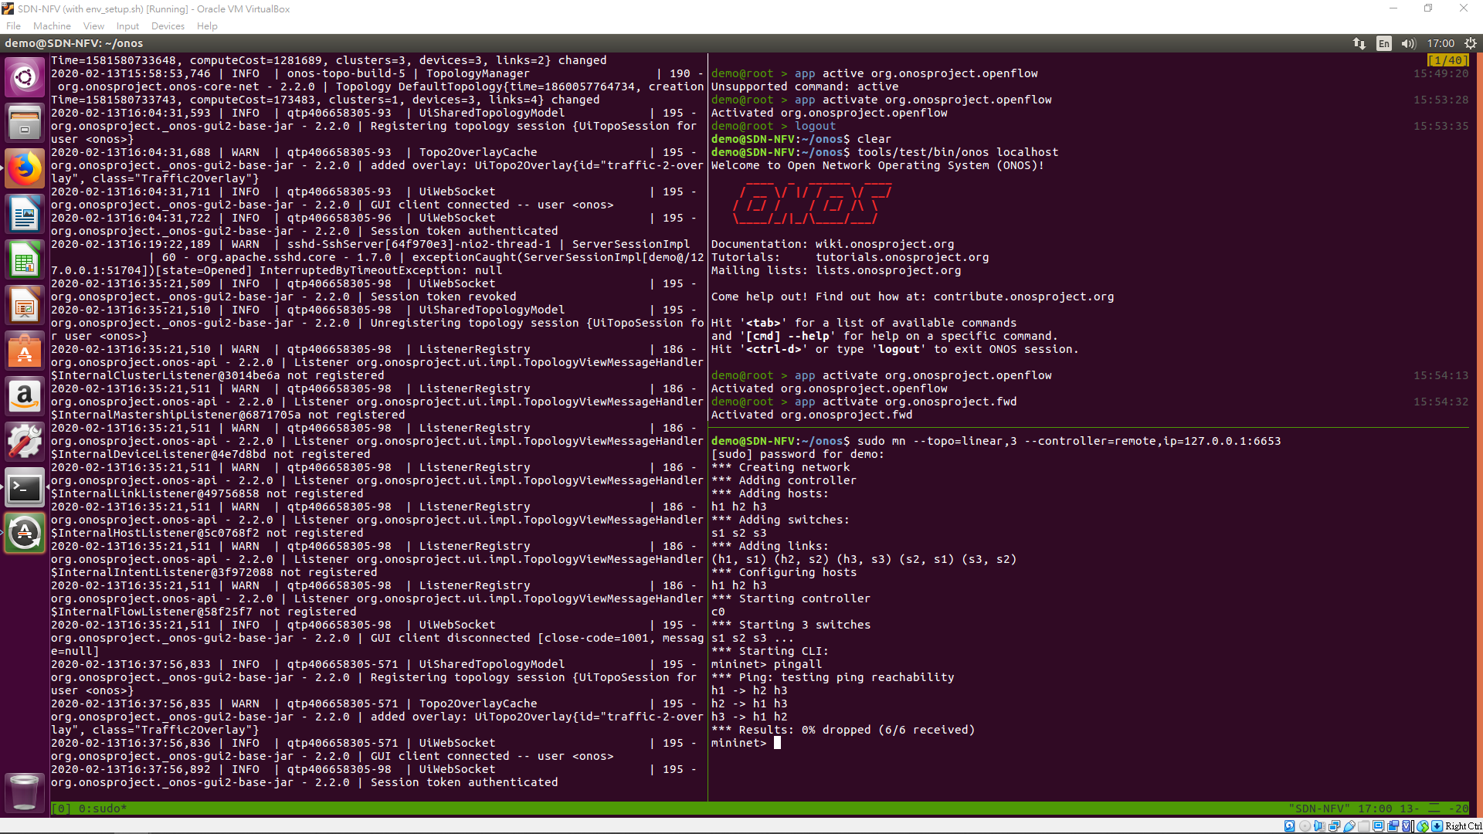
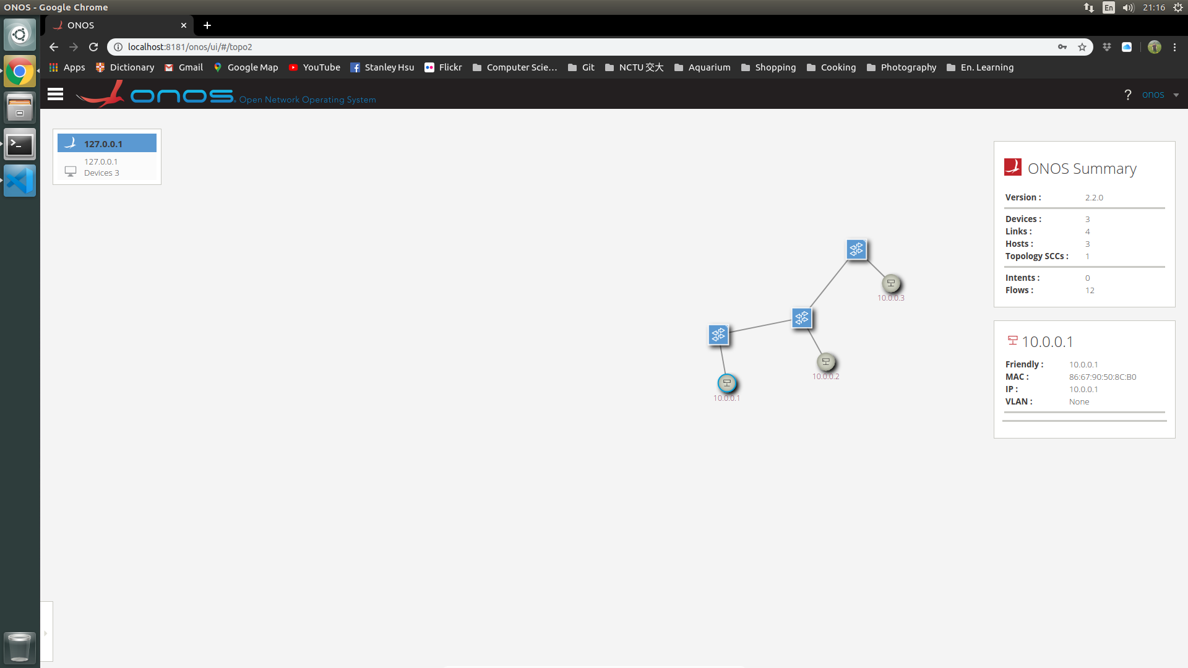
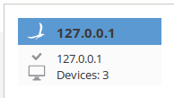
Make hosts appear in ONOS GUI
First, use “pingall” in the Mininet CLI
Press “h” in ONOS GUI to see hosts
mininet> pingall # ping between all hosts
s3
s2
h3
s1
Host information
h2
h1
Notes:
Us pingall to
Onos detect host only when host send packets

Slide 23
Outline
Environment Setup
VirtualBox Installation
Bazel, ONOS, Mininet and OVS Installation
Basic Operation
Activate basic ONOS APPs
Create a topology controlled by ONOS
[Method 1] Via Mininet CLI
[Method 2] Custom Topology
Create a custom topology in Mininet
Illustration of topology dictionary
Project1 requirements

Slide 24
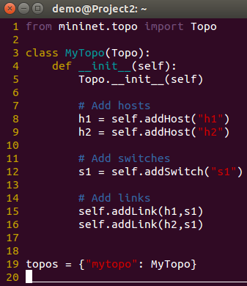
Create a custom topology in Mininet
Specify topology in Python and run the Python script
$ sudo mn --custom=sample.py --topo=mytopo \
> --controller=remote,ip=127.0.0.1,port=6653
Custom topology
s1(switch)
h1(host)
h2(host)
Sample.py

Slide 25
Illustration of topology dictionary
Need to define a dictionary in Python script (i.e. sample.py) of custom topology
Key is the short name passed to the appropriate option
Value may be subclasses, constructors or functions
$ sudo mn --custom=sample.py --topo=mytopo \
> --controller=remote,ip=127.0.0.1,port=6653
Option | dict. Name | Key : Value
--topo | topos | <short name> : <Topo constructor>

Slide 26
Outline
Environment Setup
Basic Operation
Project Requirements
Part 1: Answer Questions
Part 2: Create a Custom Topology
Bonus : Specify Hosts IP Address In Mininet

Slide 27
Project Requirement
Answer Questions (40%)
Create a Custom Topology (60%)
Bonus. Specify Hosts IP Address In Mininet

Slide 28
Part 1: Answer Questions
Activate ONOS APPs
When activating “org.onosproject.openflow”, what are the APPs which also be activated?
Which APP enables hosts to ping each other?
Hint: Please refer to the reference “Basic ONOS Tutorial”[1] attached at the end of slide
Observe listening port
Openflow protocol defines the TCP port for connection between controller and switch. What is the number of this port?
Regarding to the previous question, which APP enables that TCP port be listening?
Hint: Observation of network connection
bring up a new terminal
use the command “netstat” to print network connection
$ netstat -tnlp #show only listening TCP sockets

Slide 29
Part 2: Create a Custom Topology
Edit a Python script to build the following topology:
Hand in the Python script you edit in this part
s3(switch)
s4(switch)
s1(switch)
s2(switch)
h1(host)
h2(host)
h3(host)
h4(host)

Slide 30
Part 2: Naming Convention & Command
Name of Python script: project1_<studentID>.py
Name of topology class: Project1_Topo_<studentID>
Name of dictionary’s key: topo_<studentID>
Command to execute your script:
$ sudo mn --custom=project1_<studentID>.py \
> --topo=topo_<studentID> \
> --controller=remote,ip=127.0.0.1:6653

Slide 31
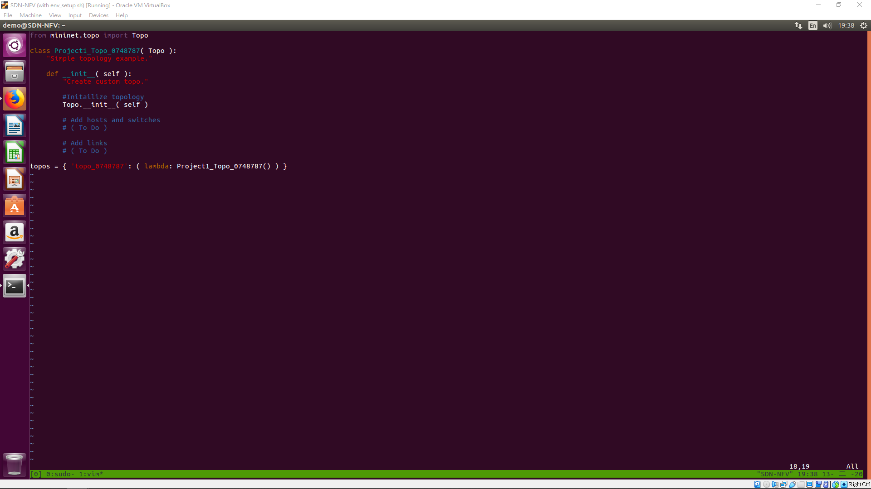
Part 2: Example of Naming Convention
In this case, should use the following command:
$ sudo mn --custom=project1_0748787.py \
> --topo=topo_0748787 \
> --controller=remote,ip=127.0.0.1:6653

Slide 32
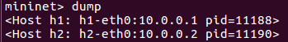
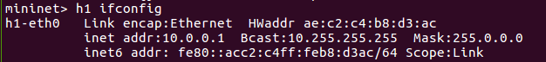
Bonus: Manually Assign Hosts IP Address In Mininet (I)
By default, Mininet will automatically assign an ip address and a subnet mask to each interface of each host
(i.e. 10.0.0.1/8, 10.0.0.2/8, 10.0.0.3/8)
Reuse the topology created in part 2

Slide 33
Bonus: Manually Assign Hosts IP Address In Mininet (II)
Manually assign each host’s ip address in the following format:
192.168.0.<host_number>
Note: host_number starts from 1
e.g.
Take screenshots of the result of the Mininet command “dump” and “pingall” in Mininet CLI
Hand in the Python script you edit in this part
Note: activate “org.onosproject.fwd” in ONOS before “pingall”
Host | IP Address
h1 | 192.168.0.1
h2 | 192.168.0.2
... | ...
mininet> dump # dump all the node info
… (result) …
mininet> pingall # ping between all hosts
… (result) ...

Slide 34
About Submit
Report & Python script

Slide 35
Submit to new e3
Files
Two Python scripts:
project1_<studentID>.py
bonus_<studentID>.py
A report: project1_<studentID>.pdf
Part 1: Answers to four questions
Part 2: Take screenshots (ONOS GUI and CLI) and explain what you’ve done
Bonus: Take screenshots (ONOS GUI and CLI) and explain what you’ve done
Also write down what you’ve learned or solved
Submit
Zip Python scripts and the report into a zip file
Named: project1_<studentID>.zip
Wrong file name or format would not be scored

Slide 36
Thank you
Q & A

Slide 37
Reference
Basic ONOS Tutorial
https://wiki.onosproject.org/display/ONOS/Basic+ONOS+Tutorial
Introduction to Mininet
https://github.com/mininet/mininet/wiki/Introduction-to-Mininet
MIninet Python API
http://mininet.org/api/annotated.html
Manpage for Linux command
netstat
http://manpages.ubuntu.com/manpages/trusty/man8/netstat.8.html
mn
http://manpages.ubuntu.com/manpages/bionic/man1/mn.1.html

Slide 38
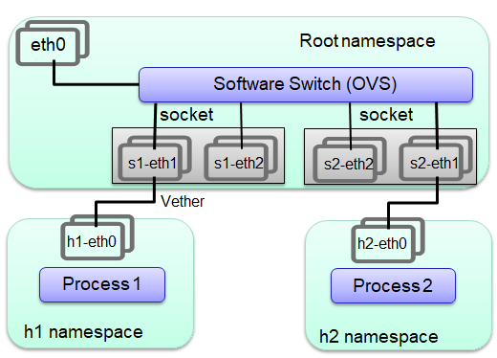
Appendix: Network Topology for Mininet Emulation
Mininet employs lightweight virtualization features in the Linux kernel, including process groups, CPU bandwidth isolation, and network namespaces
An emulated host in Mininet is a group of user-level processes moved into a network namespace

